Slide 1
Unit – 2
Database Architecture and Components
Database Systems
Asif Sohail
University of the Punjab
Punjab University College of Information Technology (PUCIT)

Slide 2
Database Architecture
To support data independence and multiple user views, DBMS employs the following three level architecture.
    External Level / Layer
    Conceptual Level / Layer
    Internal Level / Layer
This architecture is also called ANSI-SPARC architecture proposed by Standards Planning and Requirements Committee (SPARC) of ANSI.
The objective of the three-level architecture is to separate each user’s view from the way database is physically represented.

Slide 3
Database Architecture
External View- 1
External View- 2
External View- n
External / Conceptual Mapping
Logical Data Independence
Conceptual Level
Conceptual / Internal Mapping
Physical Data Independence
Physical Level

Slide 4
Continued…
Program Report Definition
Program display Definition
Program transaction Definition
User View 1
(report)
User View 2
(screen display)
User View 3
(transaction)
Conceptual
Schema
Physical
Schema

Slide 5
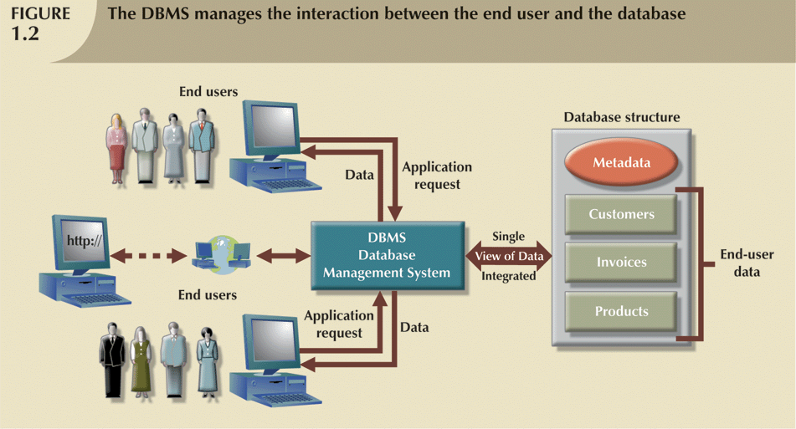
Continued…

Slide 6
Continued…
continue…
Sales Officer
Inventory Controller
External
Level
View 1
Item_Name
Price
View 2
Item_Name
Stock
Conceptual
Item_Number Character (6)
Item_Name Character(30)
Price Numeric(5,2)
Stock Numeric(4)
Conceptual
Level
Physical
Stored_Item Length=50
Item # Type = Byte(6), offset = 0, Index = Ix
Name Type = Byte(30), offset = 6
Price Type = Byte(8), offset = 36
Stock Type = Byte(4), offset = 44
Physical
Level

Slide 7
Database Architecture
1. External Level / Layer
It is the individual user level.
External Schema is used to generate different external views and external records.
An External Record is a Record as seen by a particular user.
DBMS uses External Schema to create a User Interface, which is both facility and barrier.
An External Record may be a virtual one created by combining different Physical Records, Hiding certain data items and performing operations on them.
The external schema evolves as the user needs are changed over time.

Slide 8
Database Architecture
2. Conceptual Level / Layer
This level describes what data is stored in the database and the relationships among the data.
It includes the logical structure of the database as seen by the DBA.
It also includes the constraints on data, security and integrity information.
Conceptual Schema is used to generate the conceptual view or conceptual record.
The conceptual view is a view of the data “as it really is” rather than as seen by the users.

Slide 9
Database Architecture
3. Internal Level / Layer
The physical representation of the database on the computer.
It describes where and how the data is stored on the storage devices.
It includes all the internal/physical details such as pointers, indexes, hashing, file organization etc.
This level deals with low-level access methods and how bytes are transferred to and from storage devices.
Internal Schema is used to describe the Internal Record.
An Internal Record is a single stored record.
Physical Level is managed by OS under the direction of DBMS.

Slide 10
Database Architecture
Schemas and Mappings
The overall description of the database is called the database schema.
We have three schemas i.e. external schema, conceptual schema and internal schema.
The DBMS is responsible for mapping between these three types of schemas.
The External – Conceptual Mapping defines the correspondence between a particular External view and Conceptual view.
The Conceptual – Internal Mapping defines the correspondence between the Conceptual view and Internal view.

Slide 11
Types of Data Independence
The major objective for the three-level architecture is to provide data independence, which means that the upper levels are unaffected by changes to lower level.
There are two types of data independence:
Logical Data Independence
Physical Data Independence.

Slide 12
Types of Data Independence
1. Logical Data Independence
It refers to the immunity of the external levels to the changes in the conceptual level i.e. conceptual level changes are possible without affecting the existing external levels.
The user for whom the changes are made shouldn’t affect the other users and other application programs.

Slide 13
Types of Data Independence
2. Physical Data Independence
It refers to the immunity of the conceptual level to the changes in the internal level i.e. internal level changes are possible without affecting the existing conceptual level.
The internal level changes such as a different physical sequencing of the records, switching from one access method to another, change of data structure, using new storage device etc. should have no effect on the conceptual level.

Slide 14
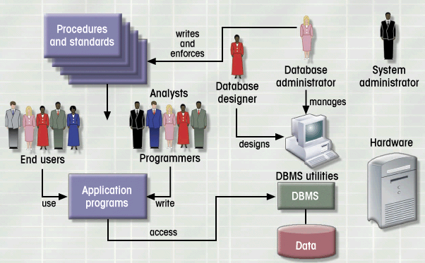

Database Environment

Slide 15
Components of Database Environment
  Application Programs
  Repository
  Database
  DBMS
  User Groups

Slide 16
Components of Database Environment
User Groups
Applications
DBMS
Repository
Database

Slide 17
Components of Database Environment
1. Applications
These are the programs used to interact with DBMS and perform all the necessary operations.
These form the Front End for end users
The language used for performing different operations on database is SQL: Structured Query Language pronounced as Sequel.
2. Database
An organized collection of logically related data, usually designed to meet the information needs of multiple users in organization.
It contains all the occurrences of data i.e. Actual Data.

Slide 18
Components of Database Environment
3. Repository – Data Dictionary (D/D)
It contains all the data definitions and relationships among them.
The data contained in D/D is called meta data.
D/D includes the information such as field names, data types, size, constraints, aliases, owner, security restrictions, schemas and mapping information etc.
The D/D may be regarded as a database in its own right, but a system database rather than a user database.
D/D is mandatory for DBMS operations.
D/D has the same significance for DBMS as is the significance of File Allocation Table for an O.S.

Slide 19
Components of Database Environment
4. DBMS
Commercial software system used to define, create, maintain, and provide controlled access to the database and also to the repository.
Three basic functions include:
  Defining a database – specifying the metadata (data types, constraints, etc.) for data storage
  Constructing a database – storing data
  Manipulating a database – querying the database for specific data, updating the database and generating reports from the data
It manages all the tasks like memory management, user rights, recovery etc.
Examples: MS Access, Oracle, SQL Server, MySQL etc.

Slide 20
Components of Database Environment
4. DBMS - Languages
DDL (Data Definition Language): It allows the user to define database structure, data types and the constraints on the data to be stored in the database.
DML (Data Manipulation Language): It allows the user to insert, update, delete and retrieve data from the database.
DCL (Data Control Language): It allows the user to define different users of the database and their privileges.

Slide 21
Components of Database Environment
5.User Groups
System Developers
End Users
i) Naïve Users (Entry Level)
ii) Sophisticated Users (Experienced)
c) Database Administrator (DBA)
DBA is a person responsible for overall management and control of the system. It includes the functions such as:
  Discussing / Liaising with the users and identifying their requirements
  Developing & Maintaining D/D
  Defining Security & Integrity checks
  Maintaining Backup & Recovery
  Monitoring performance and responding to the changing requirements & new technology
  Developing operating procedures

Slide 22
Functions of DBMS (Utilities)
  Loading
  Data storage, retrieval and update
  Data transformation and presentation
  Integrity services
  Transaction support
  Concurrency control services
  Backup and Recovery services
  Authorization services
  Performance monitoring

Slide 23
Components of DBMS
DBMS is highly complex and sophisticated piece of software that aims to provide the services as discussed.
A DBMS is partitioned into several software components or modules, each of which is assigned a specific operation.
  Database engine
  Data dictionary
  Query processor
  Report writer
  Forms generator
  Communication & integration utilities
  Security utilities

Slide 24
Components of DBMS
Database Engine – responsible for storing, retrieving, and updating the data
Data Dictionary – holds the metadata of the data tables
Query Processor – allows users to store and retrieve data with the use of a query language
Report Writer – generates database reports
Forms Generator – helps to create input forms for tasks such as data entry
Application generator – has tools (menus, toolbar generators, etc) to assist the developer in creating a complete application
Communication and integration utilities – help data storage and usage on different machines, from different locations
Security utilities – establish and maintain security access controls

Slide 25
Thank you for your attention.
Asif Sohail
Assistant Professor
University of the Punjab
Punjab University College of Information Technology (PUCIT)
Allama Iqbal (Old) Campus, Anarkali
Lahore, Pakistan
Tel: +92-(0)42-111-923-923 Ext. 154
E-mail: asif@pucit.edu.pk

